Slide 1
Temporally Reliable Motion Vectors for Real-time Ray Tracing
Zheng Zeng¹, Shiqiu Liu², Jinglei Yang³, Lu Wang¹ and Ling-Qi Yan³
Notes:
Hello everyone!
I’m going to talk about our work called Temporally Reliable Motion Vectors for Real-time Ray Tracing,

Slide 2
Temporally Reliable Motion Vectors for Real-time Ray Tracing
Notes:
In this work, we address the ghosting and lagging artifacts in real-time ray tracing using our motion vectors.
To explain where these artifacts come from, I’ll first give a little background.

Slide 3
Background

Slide 4
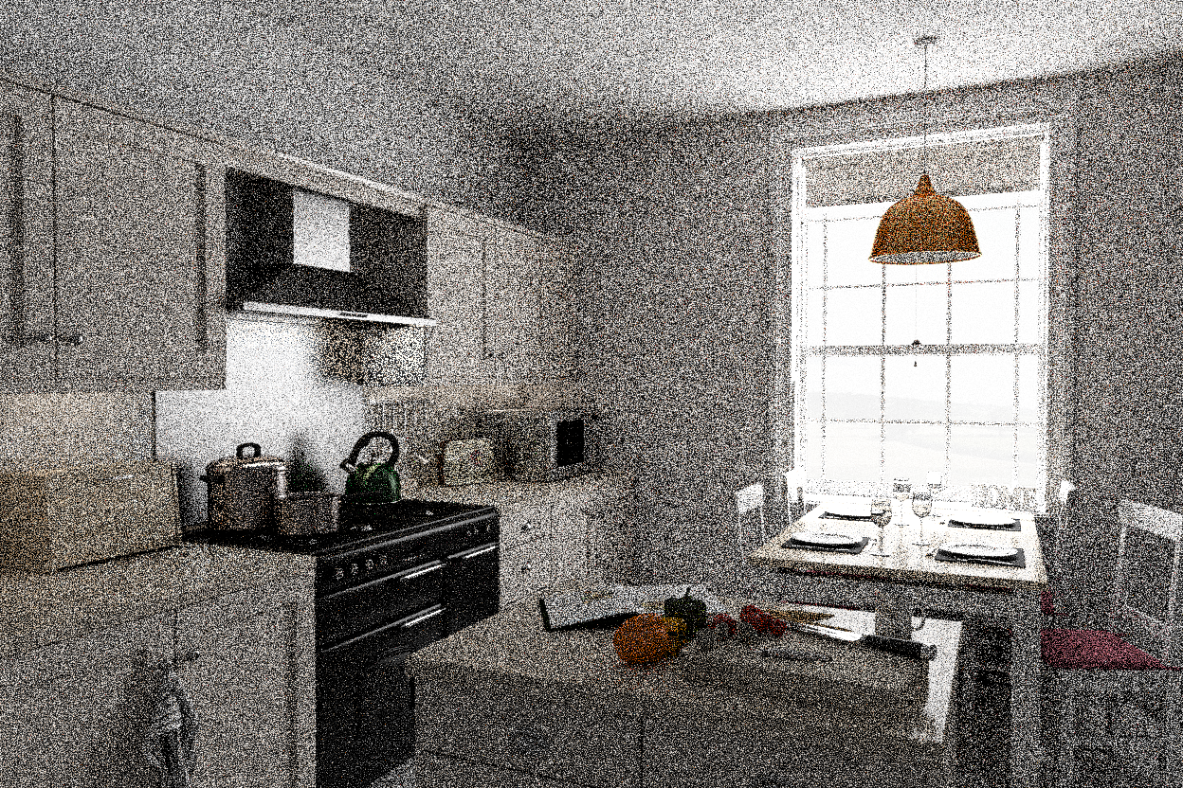
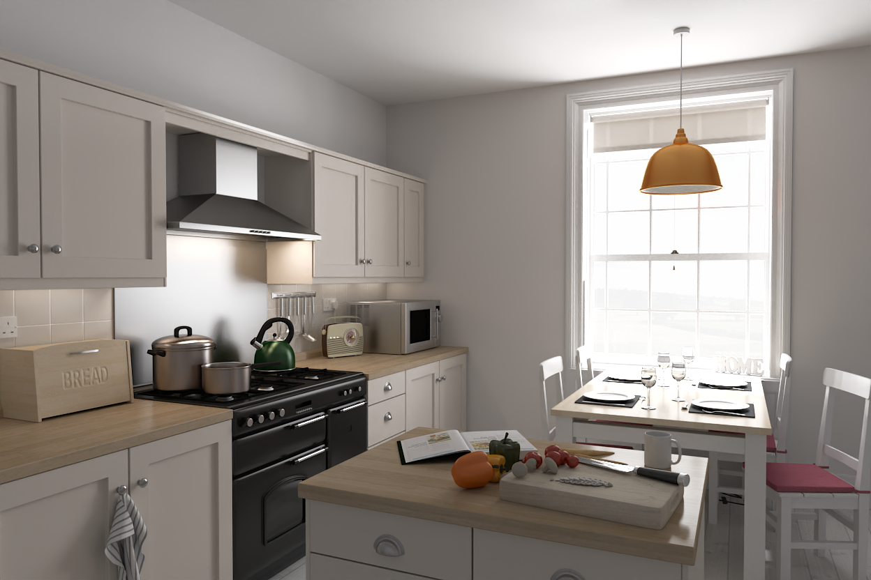
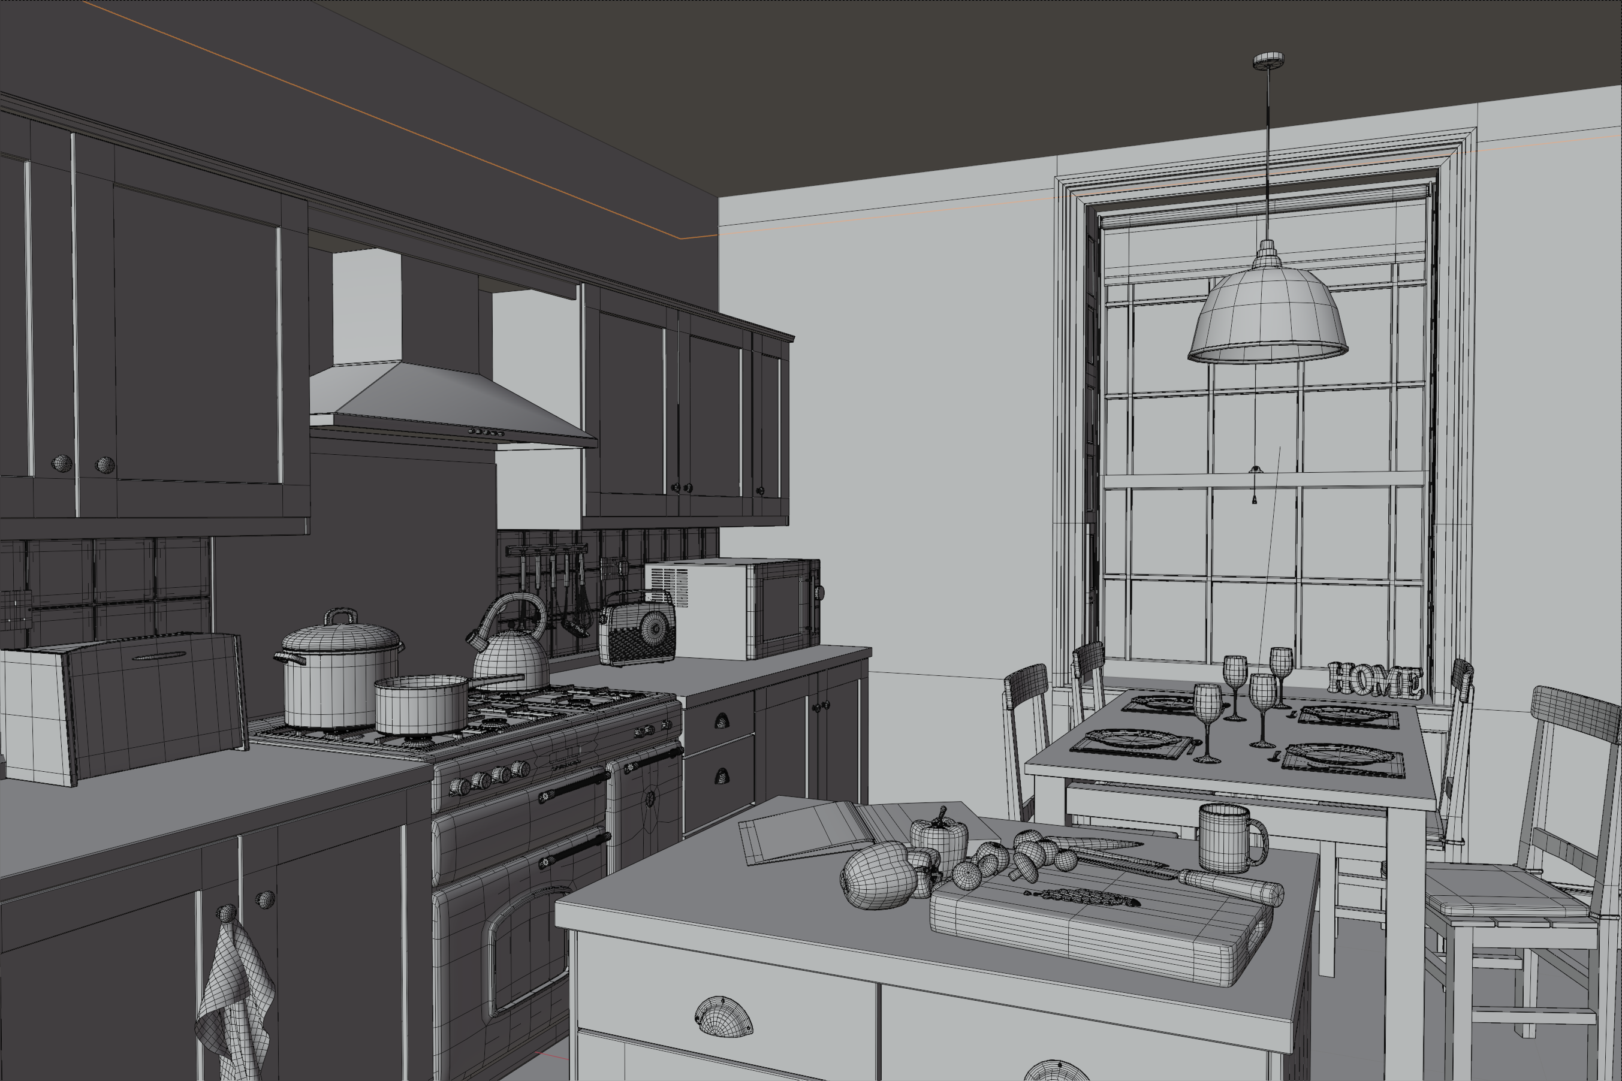
Real-time ray tracing
Secondary shadow
Secondary ray
Primary shadow
Primary ray
Rendered image
3D Scene
[Country Kitchen by Jay-Artist]
Only 4 rays per pixel
Noisy
Low sampling rates
Notes:
Nowadays, real-time ray tracing is increasingly being used in a variety of industries.
(click) However, despite the rapid progress, it still only allows for low sampling rates.
(click) For example, In order to guarantee real-time performance, for each pixel, only 4 rays can be traced.
(click) As a result, the rendered image will be noisy.
To improve the essential sampling rate, many research directions have been explored.

Slide 5
Temporal filtering
Frame $i$
Notes:
Among these directions, the temporal filtering method stands out.
For better explanation of how it works, let’s zoom in a little bit.

Slide 6
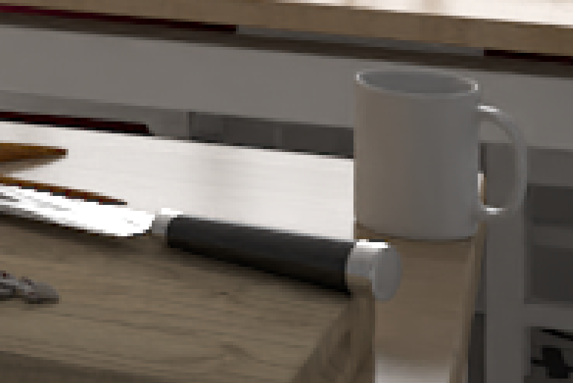
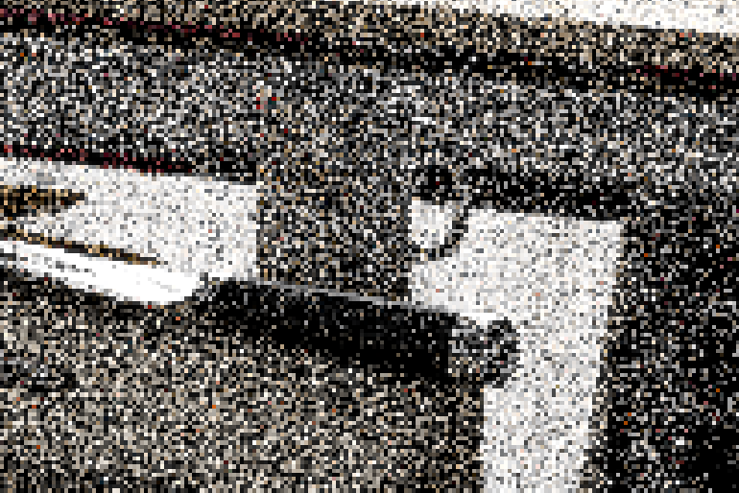
Temporal filtering
*Spatial filtering
Frame $i$
Frame $i−1$
$${{\tilde{c}}_{i}(x}_{i})$$
$${{\overline{c}}_{i−1}(x}_{i−1})$$
Notes:
For a pixel [x i] in current noisy frame,
(c1) It finds the corresponding pixel [x i-1] in previous frame

Slide 7
Temporal filtering
*Spatial filtering
Frame $i$
Frame $i$
Frame $i−1$
How to find such correspondence?
$${{\overline{c}}_{i}(x}_{i})=$$
$${{\tilde{c}}_{i}(x}_{i})$$
$${{\overline{c}}_{i−1}(x}_{i−1})$$
$$α×{c_{i}(x}_{i}) +\left(1−α\right)×$$
Notes:
Then, it linearly blends these two pixels, using a blending factor [alpha].
The [alpha] is a factor between 0 and 1 that determines how much temporal information is trusted and used. We usually set it to 0.1 to 0.2 in practice.
(c1) In this way, the shading results are accumulated and smoothed.
(c2) Now, the question is, how to find such correspondence?

Slide 8
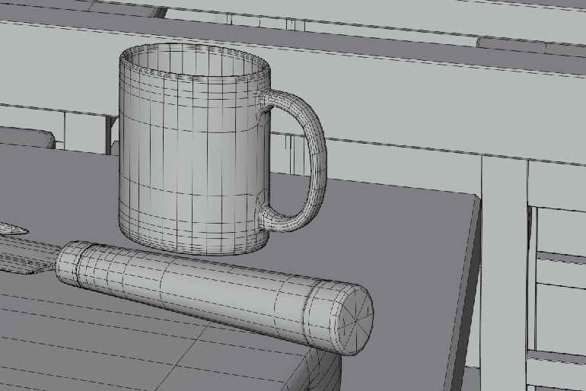
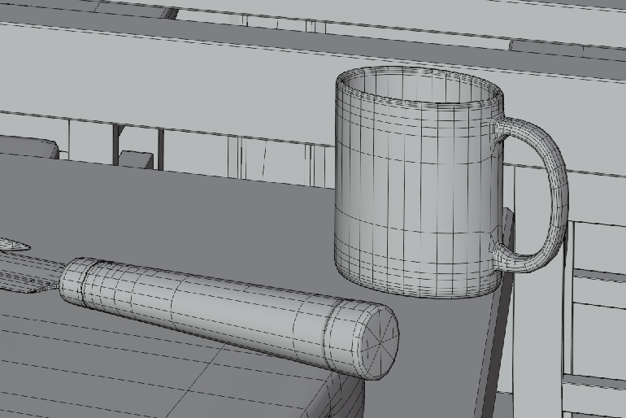
Back-projection
How to find such correspondence?
Pixel: $x_{i}$
Pixel: $x_{i−1}$
Frame $i$
$$P_{i}^{−1}$$
Frame $i−1$
$$P_{i−1}$$
$$x_{i−1}$$
$$P_{i}^{−1}$$
$${=P}_{i−1}$$
$$T^{−1}$$
$$x_{i}$$
Shading point: $s_{i}$
Transformation: $T^{−1}$
Shading point: $s_{i−1}$
World space (Frame $i$)
World space (Frame $i−1$)
Notes:
We will use the technique called the back-projection.
When two consecutive frames are given,
(c1) For each pixel [x i] in current frame,
(c2) we first project it back to its world space to get the shading point [s i].
(c3) Then, according to the movement of the geometry, we transform this shading point back to the previous frame.
(c4) Finally, we project the transformed shading point back to the image space to get the corresponding pixel [x i-1].
(c5) Now, we have found the temporal correspondence.

Slide 9
Motion vectors
Pixel: $x_{i}$
Pixel: $x_{i−1}$
Motion vector: ${m(x}_{i})$
Frame $i$
Frame $i−1$
Notes:
And the red arrow here, is called the motion vector

Slide 10
Motion vectors
Pixel: $x_{i}$
Pixel: $x_{i−1}$
Motion vector: ${m(x}_{i})$
Frame $i$
$${m(x}_{i})=$$
$$x_{i−1}$$
-
$$x_{i}$$
Notes:
It literally is a 2D vector in the image space that points from the current pixel location to its previous location.

Slide 11
Motion vectors
Pixel: $x_{i}$
Pixel: $x_{i−1}$
(60, 30)
(90, 31)
Motion vector: ${m(x}_{i})$
(30, 1)
2D Texture: motion vectors
Frame $i$
$${m(x}_{i})=$$
$$x_{i−1}$$
Could we always find a valid one?
-
$$x_{i}$$
Notes:
The motion vectors are stored on a 2d texture like this.
Note the black pixels in this texture means their motion vectors are all zero-length. Since the geometries within these pixels are all static.
(c1) However, could it always find the right temporal correspondence for us?
The answer is no.

Slide 12
Typical failure 1: shadows
Frame $i$
Frame $i$
Notes:
The motion vectors may be wrong under certain cases.
The first typical failure is the shadows.
Here we have a static plane,
with a static cylinder standing on it.
(c1) Now, there is an area light source moving to left,
(c2) while casting shadows onto the plane.
(c3) Lets rewind the time to the last frame.

Slide 13
Typical failure 1: shadows
Lagging!
Frame $i$
Frame $i$
Frame $i−1$
$$α=0.2$$
${{\overline{c}}_{i}(x}_{i})=α×{{\tilde{c}}_{i}(x}_{i})+\left(1−α\right)×$ ${{\overline{c}}_{i−1}(x}_{i})$
All motion vectors are zero-length
Motion vectors of receiver’s
Notes:
If we calculate the motion vectors of the static plane’s,
(c1) we will find that the motion vectors are all zero-length, since the geometry is static.
(c2) In this case, if the temporal filtering is applied anyway, it will simply blend the pixels on the two planes.
(c3) As a result, lagging artifacts will emerge.

Slide 14
Typical failure 2: glossy reflections
Frame $i$
Frame $i$
Notes:
Another typical failure is glossy reflections.
Here we have an object moving to left.
(c1) And below the object, there is a glossy surface.
(c2) Again, lets rewind the time to the last frame.

Slide 15
Typical failure 2: glossy reflections
Lagging!
Frame $i$
Frame $i$
Frame $i−1$
$$α=0.2$$
${{\overline{c}}_{i}(x}_{i})=α×{{\tilde{c}}_{i}(x}_{i})+\left(1−α\right)×$ ${{\overline{c}}_{i−1}(x}_{i})$
All motion vectors are zero-length
Motion vectors of reflector’s
Notes:
Similar to the shadow case, all of the motion vectors of this glossy plane’s are also zero-length.
(c1) And again, lagging artifacts will emerge.

Slide 16
Typical failure 3: occlusions
Frame $i$
Frame $i$
Notes:
The next failure case is occlusions.
We have an object moving to left, and with a white wall behind it.
(c1) Now we rewind the time to the last frame.

Slide 17
Typical failure 3: occlusions
Ghosting!
Frame $i$
Frame $i$
Frame $i−1$
$$α=0.2$$
All motion vectors are zero-length
${{\overline{c}}_{i}(x}_{i})=α×{{\tilde{c}}_{i}(x}_{i})+\left(1−α\right)×$ ${{\overline{c}}_{i−1}(x}_{i})$
Motion vectors of
previously occluded region’s
Notes:
For the previously occluded regions, the motion vectors are again all zero-length.
(c1) So it will simply blend the this regions with the occluder in previous frame.
(c2) As a result, ghosting artifacts will emerge.

Slide 18
Previous Work
Notes:
Various methods are designed to alleviate the temporal failures.

Slide 19
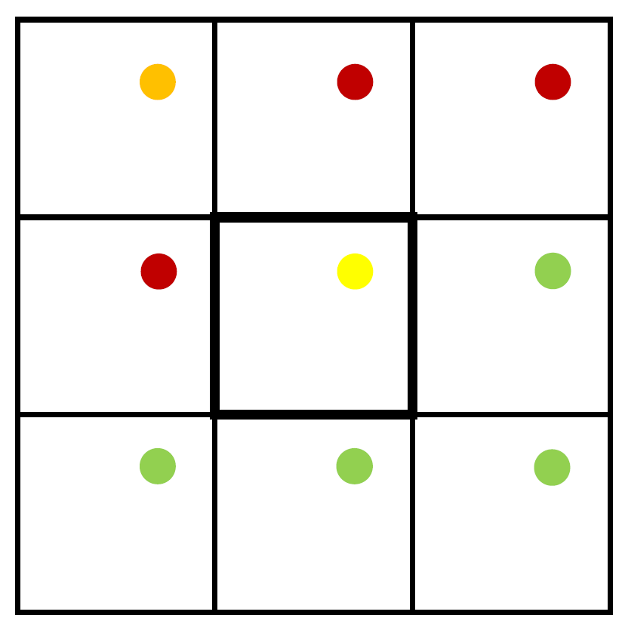
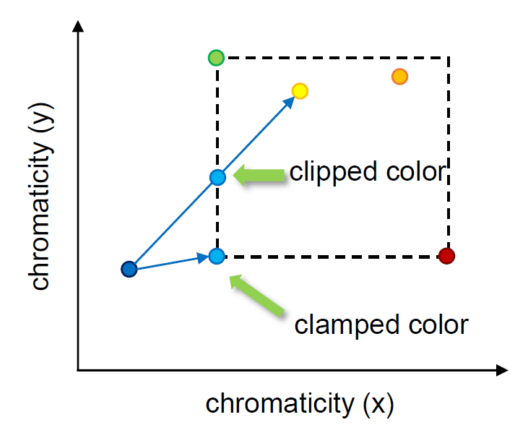
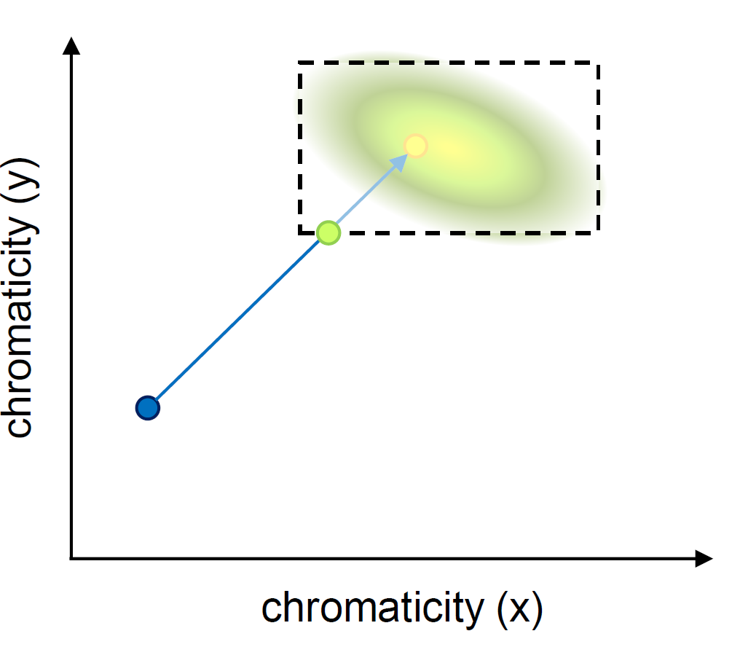
Previous work
Neighborhood Clamping (from TAA)
(History rectification)
[Karis 2014]
[Salvi 2016]
${{\overline{c}}_{i}(x}_{i})=α×{{\tilde{c}}_{i}(x}_{i})+\left(1−α\right)×$ ${{\overline{c}}_{i−1}(x}_{i})$
Notes:
The neighborhood clamping methods first gather the color information from neighborhood pixels.
(c1) Then, they compute an axis-aligned bounding box or a Gaussian distribution of the colors.
And finally, clamp or clip the history color according to it.
(c2) This kind of method aims at rectifying the history color, in order to suppress the ghosting artifacts.

Slide 20
Previous work
Neighborhood Clamping (from TAA)
(History rectification)
SVGF
(Better spatial filtering scheme)
[Schied et al. 2017]
${{\overline{c}}_{i}(x}_{i})=α×{{\tilde{c}}_{i}(x}_{i})+\left(1−α\right)×$ ${{\overline{c}}_{i−1}(x}_{i})$
[Karis 2014]
[Salvi 2016]
${{\overline{c}}_{i}(x}_{i})=α×{{\tilde{c}}_{i}(x}_{i})+\left(1−α\right)×$ ${{\overline{c}}_{i−1}(x}_{i})$
Notes:
The spatiotemporal variance-guided filtering (SVGF) method analyzes both spatial and temporal variances to guide the shape and size of spatial filters.
This method focuses on a better spatial filtering scheme to acquire better current result.

Slide 21
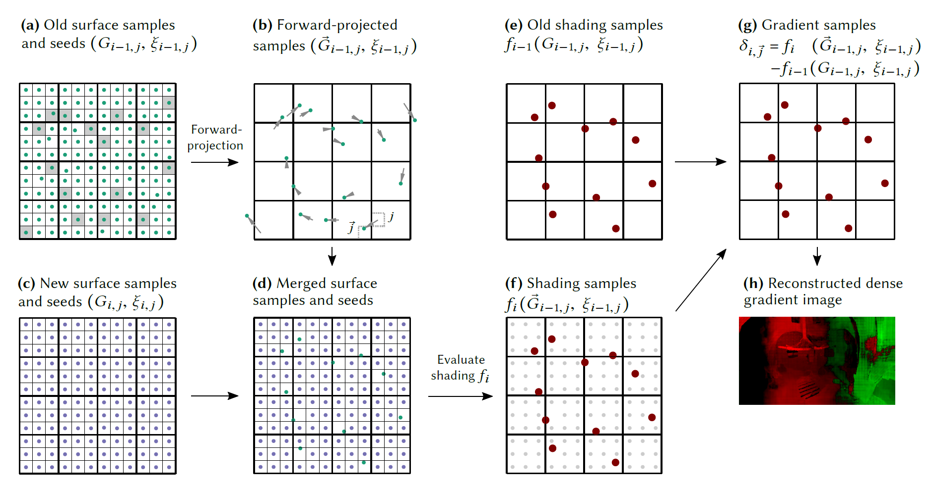
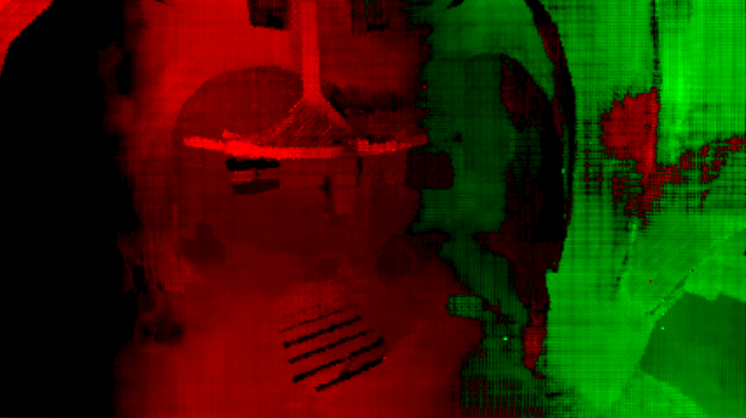
Previous work
Neighborhood Clamping (from TAA)
(History rectification)
SVGF
(Better spatial filtering scheme)
[Schied et al. 2017]
${{\overline{c}}_{i}(x}_{i})=α×{{\tilde{c}}_{i}(x}_{i})+\left(1−α\right)×$ ${{\overline{c}}_{i−1}(x}_{i})$
[Karis 2014]
[Salvi 2016]
A-SVGF
(Adjust the blending factor $α$)
[Schied et al. 2018]
${{\overline{c}}_{i}(x}_{i})=α×{{\tilde{c}}_{i}(x}_{i})+\left(1−α\right)×$ ${{\overline{c}}_{i−1}(x}_{i})$
${{\overline{c}}_{i}(x}_{i})=α×{{\tilde{c}}_{i}(x}_{i})+\left(1−α\right)×$ ${{\overline{c}}_{i−1}(x}_{i})$
Notes:
And the ASVGF method detects rapid temporal changes to adjust the blending factor α, to rely more or less on spatial filtering, trading ghosting artifacts for noise.

Slide 22
Our goal
Previous work
Our goal
Detect the temporal failures
Either rectify or reject the wrong temporal information
Find more reliable temporal information
For shadows, glossy reflections and occlusions
SVGF
(Better spatial filtering scheme)
[Schied et al. 2017]
${{\overline{c}}_{i}(x}_{i})=α×{{\tilde{c}}_{i}(x}_{i})+\left(1−α\right)×$ ${{\overline{c}}_{i−1}(x}_{i})$
Neighborhood Clamping (from TAA)
(History rectification)
[Karis 2014] [Salvi 2016]
A-SVGF
(Adjust the blending factor $α$)
[Schied et al. 2018]
${{\overline{c}}_{i}(x}_{i})=α×{{\tilde{c}}_{i}(x}_{i})+\left(1−α\right)×$ ${{\overline{c}}_{i−1}(x}_{i})$
${{\overline{c}}_{i}(x}_{i})=α×{{\tilde{c}}_{i}(x}_{i})+\left(1−α\right)×$ ${{\overline{c}}_{i−1}(x}_{i})$
Notes:
All of the previous methods are aiming at detecting the temporal failures, and either rectifying or rejecting the wrong temporal information.
(c1) In contrast to previous methods, our goal is to find more reliable temporal information.
Specifically, we will focus on the three commonly encountered temporal failure cases, shadows, glossy reflections and occlusions.

Slide 23
Our Method
Notes:
Now let’s take a look at our method.

Slide 24
Our method
For shadows, glossy reflections and occlusions:
Motion vector for shadows
Motion vector for glossy ref.
Motion vector for occlusions
Shading
Direct illumination
without shadows
Visibility
Shadows
Glossy Reflections
Indirect illumination for specular / glossy materials
Indirect illumination
Indirect illumination for
other materials
Can be approximated by
Linearly Transformed Cosines (LTC)
[Heitz et al. 2016]
Notes:
The high level idea is that we design a separate motion vector for each of these effects.
(c1) In accordance with the different types of motion vectors, we also treat our final output as a collection of separate components.
(c2) Using the LTC method, the shading part can already be reasonably approximated in a noise-free way,

Slide 25
Our method
For shadows, glossy reflections and occlusions:
Visibility
Glossy Reflections
Indirect illumination
Motion vector for shadows
Motion vector for glossy ref.
Motion vector for occlusions
Notes:
So now we only need to apply each of our motion vectors to the remaining three components respectively.
(c1) Let’s first take a look at our motion vector for shadows.

Slide 26
Shadows: where is the temporal correspondence?
Track the geometry
Track the movement of shadow
Can we find a similar shadow in previous frame?
Frame $i$
Frame $i−1$
Frame $i$
Frame $i−1$
How to track the movement of shadows?
Motion vectors of receiver’s
Notes:
Remember that all we want to do is to find the right temporal correspondence for a pixel in current frame.
(c1) We already know that, for shadows, tracking the movement of geometry is not working.
(c2) Our key observation is, can we find a similar shadow in previous frame?
(c3) The answer is yes. These pixels in the previous frame should be the right temporal correspondences.
(c4) So our insight is, for shadows, it is not the geometry we want to track, but the movement of shadows.
(c5) Now, the questions is, how to track the movement of shadows?

Slide 27
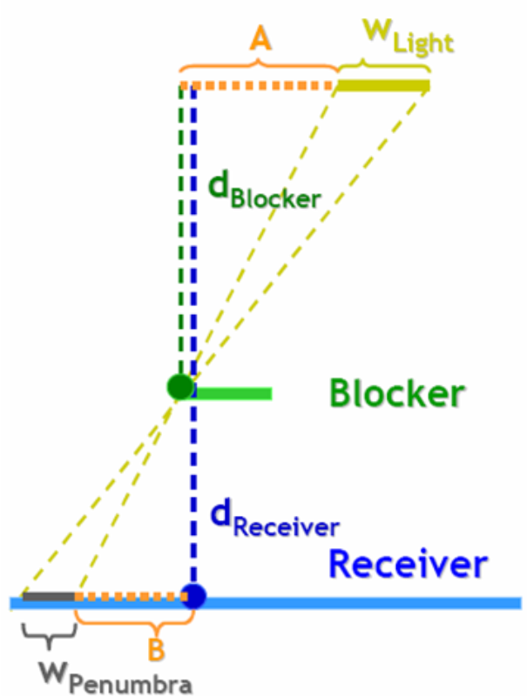
Shadow motion vector: calculation
How to track the movement of shadows?
$l_{i}$
Light
$l_{i−1}$
Percentage Closer Soft Shadows (PCSS)
[Fernando 2016]
Our shadow motion vector is:
$$T^{−1}$$
$b_{i}$
$b_{i−1}$
$${m^{V}\left(x_{i}\right)=x}_{i−1}^{V}−x_{i}$$
Blocker
$$T^{−1}$$
Receiver
$s_{i}$
$s_{i−1}$
Frame $i$
Frame $i−1$
Assumption: locally flat surface
What if the surface isn’t flat?
$$x_{i−1}^{V}=P_{i−1}$$
$$s_{i−1}=$$
$$intersect( )$$
$$\left(T^{−1}l_{i}→T^{−1}b_{i}\right);$$
$${ T}^{−1}Plane(s_{i})$$
Notes:
Inspired by the PCSS method, we propose to track the movement of the shadow by following the blocker and light positions over time.
(c1) Given two consecutive frames,
(c2) for a pixel in shadow, we know exactly the world space position of its shading point si,
the blocker position bi, and the light sample position li
(c3) Since the blocker and the light sample positions are associated with certain objects, we immediately know their positions in the previous frame.
(c4) Now, suppose that the geometry around si is a locally flat surface,
We can easily find the intersection s_i-1 between this plane and the line connecting l_i-1 and b_i-1。
(c5) Finally, we project this intersection to the image space. And this projected pixel is our tracked shadow position.
(c6) Our motion vector can be formally written as this:
Note that the only assumption we made is that the geometry is locally flat surface.
(c7) But what if the surface isn’t flat?

Slide 28
Non-planar case
What if the surface isn’t flat?
$l_{i}$
Light
$l_{i−1}$
$$T^{−1}$$
$b_{i}$
$b_{i−1}$
Blocker
$$T^{−1}$$
Receiver
$s_{i}$
$s_{i−1}$
Frame $i$
Frame $i−1$
Notes:
For example,

Slide 29
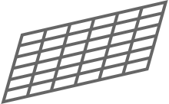
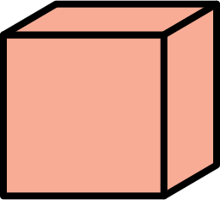
Non-planar case
What if the surface isn’t flat?
Only when $θ$ is close to $90°$,
fully depend on temporal result.
Otherwise,
trust more on the current result.
$l_{i}$
Light
$l_{i−1}$
$$T^{−1}$$
$b_{i}$
$b_{i−1}$
Blocker
$$T^{−1}$$
$$x_{i−1}^{V}$$
$$n(s_{i})$$
$$s_{i−1}^{V}$$
Use $θ$ to adjust the $α$!
$$θ$$
Receiver
$s_{i}$
$s_{i−1}$
$$α^{V}=1−Gaussian\left(θ−\frac{π}{2};0,0.1\right)×(1−α)$$
Frame $i$
Frame $i−1$
${{\overline{c}}_{i}(x}_{i})=α^{V}×{{\tilde{c}}_{i}(x}_{i})+\left(1−α^{V}\right)×$ ${{\overline{c}}_{i−1}(x}_{i−1})$
Notes:
there is a box above this intersection.
(c1) Then the real shading point in previous frame is on the top of the box.
To deal with this situation, we introduce a simple but effective falloff heuristic. That is, we measure the extent of “non-planarity”
(c2) we connect these two shading points, and measure the angle [theta] between the normal of the plane and this line.
(c3) Our key observation is that only when 𝜃 is close to 90°, We can fully depend on temporal result.
(c4) Otherwise, we should trust more on the current result.
(c5) So, we use [theta] to adjust the [alpha]
Finally, we achieve high quality, non-lagging shadows.

Slide 30
Shadow motion vector: result
Notes:
We compare our results with the ones generated using traditional motion vectors, with and without the neighborhood clamping approach used in temporal filtering.
We also compare our method with the SVGF and A-SVGF.

Slide 31
Shadow Motion Vector: Result
Notes:
Note that we are able to produce shadows that are closely attached to the fence.
GT: We produce the closest result to the ground truth.
Traditional motion vectors produce significant ghosting artifacts.
With clamping, the results are less lagging but much more noisy.
SVGF method produces over-blurred and lagging shadows.
A-SVGF method discards temporal information, resulting in noisy shadows.

Slide 32
Our method
For shadows, glossy reflections and occlusions:
Visibility
Glossy Reflections
Indirect illumination
Motion vector for shadows
Motion vector for glossy ref.
Motion vector for occlusions
Notes:
Next, let’s take a look at our motion vector for glossy reflections.

Slide 33
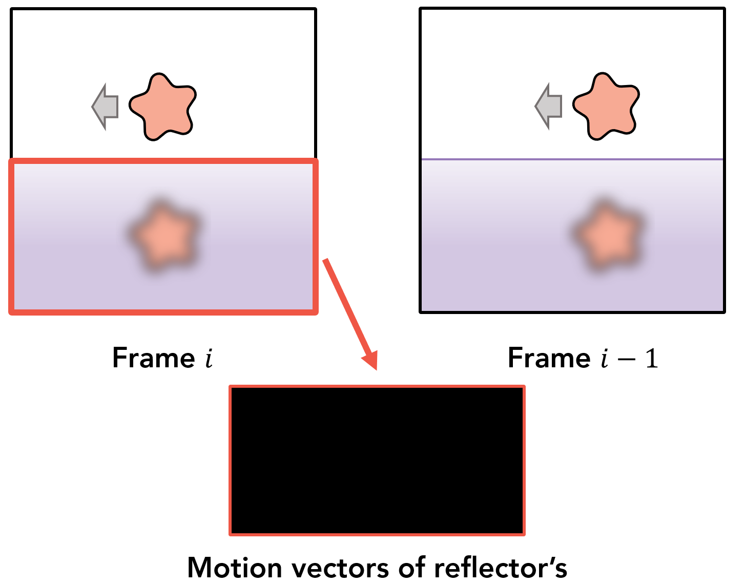
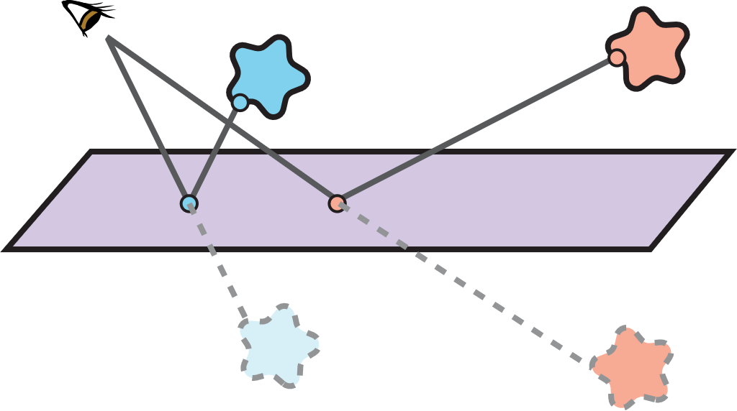
Glossy reflections: where is the temporal correspondence?
Track the geometry
Track the movement of glossy reflections
[Zimmer et al. 2015]
[Mara et al. 2017]
Mirror / specular reflections
Frame $i−1$
Frame $i$
Still valid for glossy reflections?
Notes:
Similar to tracking the shadows, we can also track the movement of glossy reflections, instead of geometry.
(c1) This is inspired by Zimmer et al. and Mara et al. on mirror / specular reflections.
They assume that the virtual image is a real object behind the mirror reflector, and calculate the motion vectors of the virtual image instead of the reflector.
(c2) However, the question is, is this still valid for glossy reflections?

Slide 34
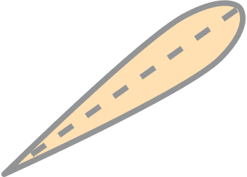
Glossy reflections: where is the temporal correspondence?
Still valid for glossy reflections?
Our insight
Goal:
Find the corresponding pixel of $x_{i}$
Observation:
Glossy BRDFs model is a non-delta distribution
Multiple shading points may reflect to the same hit point
Multiple pixels from the previous frame that correspond to $x_{i}$
Form a finite area in the screen space.
Design a stochastic motion vector, aiming at finding one pixel from this finite area at a time.
Frame $i−1$
Frame $i$
Notes:
The answer is no.
(c1) Since we trace 1 secondary ray per pixel, we can only importance sample the glossy lobe to decide where to bounce.
And the bounced direction can certainly be different to the specular reflected direction.
(c2) Our insight is that no matter if we are using the specular or sampled direction,
(c3) what we need to do is still to find the corresponding pixel in the previous frame
(c4) However, since glossy BRDFs model a non-delta distribution,
(c5) Multiple shading points may reflect to the same hit point
(c6) And there are Multiple pixels from the previous frame that correspond to xi
(c7) forming a finite area in the image space.
(c8) So, our goal is to design a stochastic motion vector, aiming at finding one pixel from this finite area at a time.

Slide 35
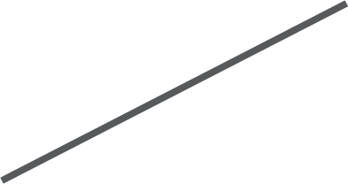
Stochastic glossy ref. motion vector: calculation
Design a stochastic motion vector, aiming at finding one pixel from this finite area at a time.
$$x_{i−1}^{R}$$
$$h_{i−1}$$
$$h_{i}$$
Our stochastic glossy ref. motion vector is:
$$s_{i−1}^{C}$$
$$s_{i}$$
$${m^{R}\left(x_{i}\right)=x}_{i−1}^{R}−x_{i}$$
Frame $i−1$
Frame $i$
$x_{i−1}^{R}=sample(P_{i−1}$ $,Σ)$
$$virtual image=$$
$$mirror[T^{−1}h_{i}, T^{−1}plane(s_{i})]$$
Notes:
We start from the importance sampled secondary ray at the shading point [si] and the secondary hit point [hi] in the world space.
(c1) We then transform [hi] to the previous frame
Since the center of a glossy BRDF lobe is usually the strongest, here we can first assume that the glossy BRDF degenerates to pure specular,
(c2) now we can immediately find find its mirror-reflected image,
(c3) next, we project it towards the screen to get [sC i−1]
Then our insight is that, as the glossy lobe gradually emerges,
(c4)a region will appear around sC i−1, in which all the points are able to reflect to the same hit point hi−1.
This region can be approximated by tracing a glossy lobe from the virtual image towards sC i−1.
(c5) In practice, there is no need to trace any cones, and we simply assume that the glossy lobe is a Gaussian in directions, and that the intersected region is a Gaussian in positions as well as in the image space. Then our stochastic motion vector can randomly sample one corresponding pixel from the gaussian function.
(c6) It can be formally written as this:

Slide 36
Stochastic glossy ref. motion vector: result
Notes:
Similar to shadows, we again compare our results with these methods. Specially, we compare with method using specular reflection motion vectors, also with clamping.

Slide 37
Stochastic Glossy Ref. Motion Vector: Result
Notes:
Ours: our glossy reflection motion vectors do not introduce ghosting artifacts.
Spec: The results of specular motion vector look plausible, but we can also find discontinuous artifacts around the edges of the reflected objects.
Trad: with traditional motion vectors, naive filtering produces significant ghosting
Trad clamp: Clamping relieves the lagging but introduces discontinuous artifacts.
ASVGF: Finally, A-SVGF will always result in noisy

Slide 38
Our method
For shadows, glossy reflections and occlusions:
Visibility
Glossy Reflections
Indirect illumination
Motion vector for shadows
Motion vector for glossy ref.
Motion vector for occlusions
Notes:
Finally, let’s take a look at our motion vector for occlusions.

Slide 39
Occlusions: where is the temporal correspondence?
Track the geometry
Neighborhood Clamping (in TAA)
(History rectification)
Find a closer color instead
In theory, there is NO temporal correspondence!
[Karis 2014]
[Salvi 2016]
A closer color value
Frame $i$
Frame $i−1$
Motion vectors of
previously occluded region’s
${{\overline{c}}_{i}(x}_{i})=α×{{\tilde{c}}_{i}(x}_{i})+\left(1−α\right)×$ ${{\overline{c}}_{i−1}(x}_{i})$
Notes:
Tracking the geometry is still not working.
However, different from shadows and glossy reflections,
(c1) When occlusion happens, in theory there are no temporal correspondences of pixels in the occluded regions.
(c2) The back-projected motion vectors of these pixels will always land on the occluders, thus the previous pixel values cannot easily be used.
(c3) To alleviate this issue, we start from the clamping methods.
(c4) They clamp the history pixel values of occluders to the current value, but is still prone to ghosting artifacts, since usually the occluders have completely different colors.
(c5) Our insight is that if the history value is closer to the current value in the occluded regions, the issues produced by the clamping method can be better resolved.
(c6) So, we propose to find a closer color instead.

Slide 40
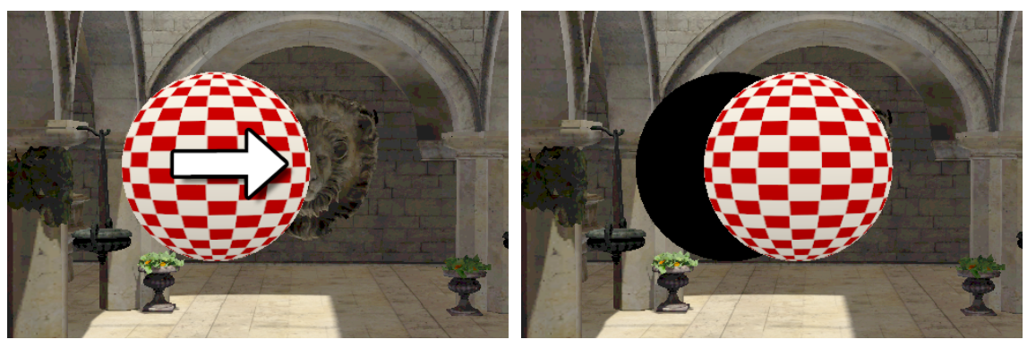
Occlusions: where is the temporal correspondence?
Track the geometry
Find a closer color instead
Close color values often
appear on _________________
the same object
[Bowles 2012]
In theory, there is NO temporal correspondence!
Relative motion!
Frame $i$
Frame $i−1$
Motion vectors of
previously occluded region’s
Design a motion vector,
using this relative motion
Notes:
We observe that the close color values often appears on
(c1) the same object.
(c2) In this case, close color values appear on the background.
So when the object moving to left, we temporally reuse the color values from the right side.
(c3) This is a relative motion!
(c4) So, Inspired by Bowles et al., we are going to design a motion vector, using this relative motion.

Slide 41
Dual motion vector: calculation
Back-projection
Design a motion vector,
using this relative motion
$z$
$x_{i}$
$y$
$x_{i−1}^{O}$
$$x_{i−1}^{O}=y+(x_{i}−z)$$
Our dual motion vector is:
forward-projection
$${m^{O}\left(x_{i}\right)=x}_{i−1}^{O}−x_{i}$$
Frame $i$
Frame $i−1$
Notes:
For each pixel xi in current frame,
(c1) the traditional motion vector using back-projection gives the xi to y
(c2) We then continues to track the movement of y to z, using the motion vector of occluder’s, that is a forward-projection.
(c3) Then, based on the relative positions of xi and z,
(c4) we are able to find the [xO i−1] in the previous frame.
(c5) Since we have applied a back-projection followed by a forward-projection, essentially using two motion vectors, we name our approach “dual motion vectors”

Slide 42
Dual motion vector: calculation
Design a motion vector,
using this relative motion
$z$
$x_{i}$
$x_{i−1}^{O}$
$y$
$$x_{i−1}^{O}=y+(x_{i}−z)$$
Our dual motion vector is:
$${m^{O}\left(x_{i}\right)=x}_{i−1}^{O}−x_{i}$$
Frame $i$
Frame $i−1$
Notes:
So far, we are able to find a much closer color value to xi on the background.

Slide 43
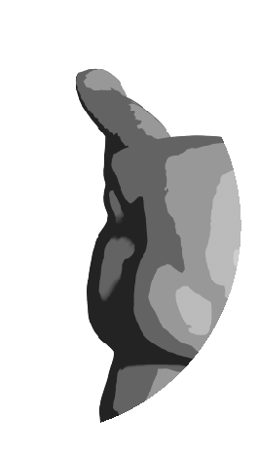
Reusing color vs. incident radiance
$z$
$x_{i}$
$x_{i−1}^{O}$
Result in clear repetitive pattern
Frame $i$
Frame $i$
Notes:
However, if the corresponding pixel land on another object,
(c1) simply applying the color values will result in clear repetitive pattern. because it is essentially copy-pasting image contents.

Slide 44
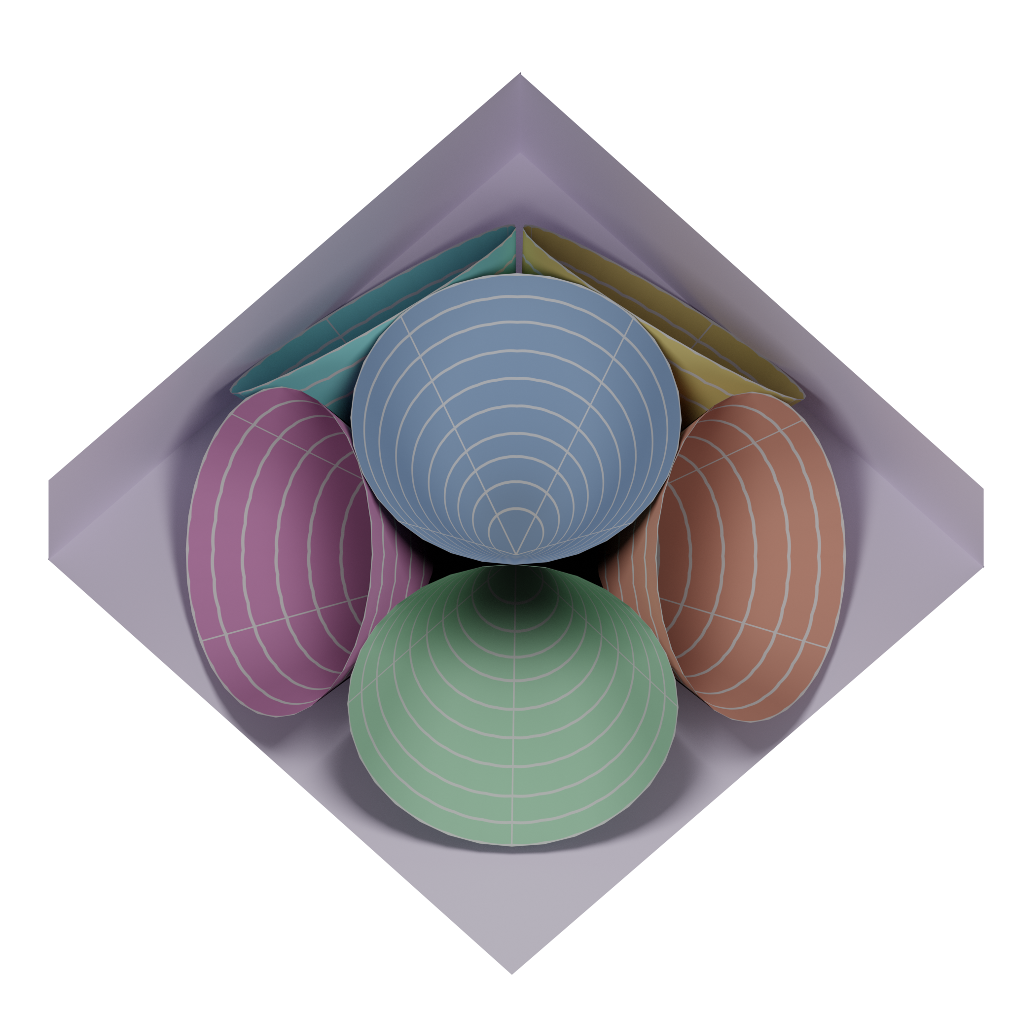
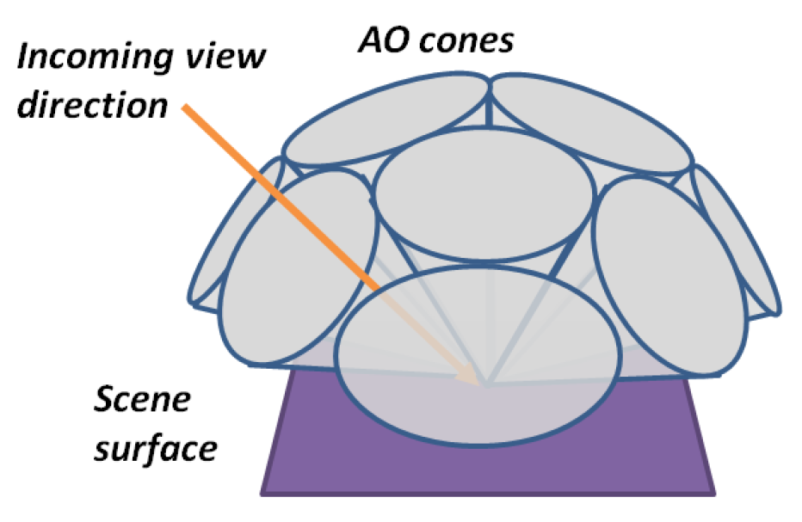
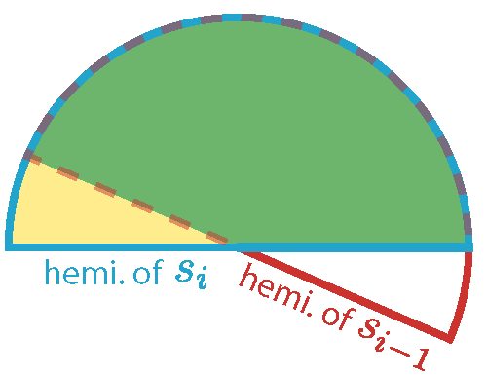
Reusing color vs. incident radiance
Voxel Cone Tracing
[Crassin 2011]
Result in clear repetitive pattern
Frame $i$
Notes:
To address this issue, we propose to temporally reuse the incident radiance instead of the shading result.
Specifically, for the application of diffuse indirect illumination, we record the 2D indirect incident radiance per pixel.
(c1) For efficiently store the 2D incident radiance per pixel, we refer to the representation in the voxel cone tracing approach.
(c2) We subdivide a hemisphere into 6 cones.
(c3) And during spatial or temporal filtering, instead of averaging the shading result, we filter for each cone individually, using the overlapping solid angles between each pair of cones as the filtering weight.

Slide 45
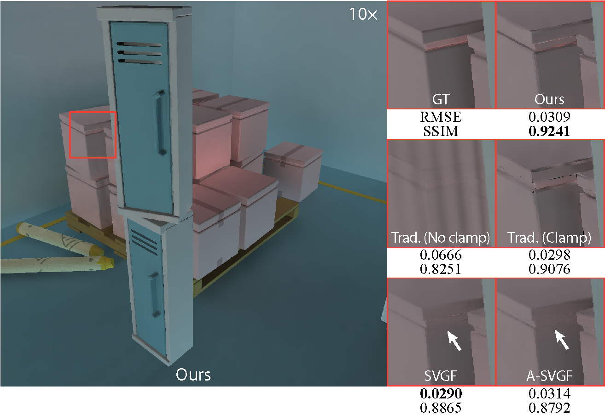
Dual motion vector: result
Notes:
We again compare our results with these methods

Slide 46
Dual Motion Vector: Result
Notes:
Ours: Our motion vectors avoid noise and ghosting, preserving details and suppressing overblur
GT: We produce the closest result to the ground truth
SVGF: SVGF method still results in significant amount of overblur
A-SVGF: A-SVGF method appears to be smeared spatially and loses temporal stability
Trad (no clamp): The traditional motion vectors introduce ghosting artifacts.
Trad (clamp): With clamping, the results are less ghosting but much more noisy.

Slide 47
Discussion
Notes:
Now let’s move to the discussion.

Slide 48
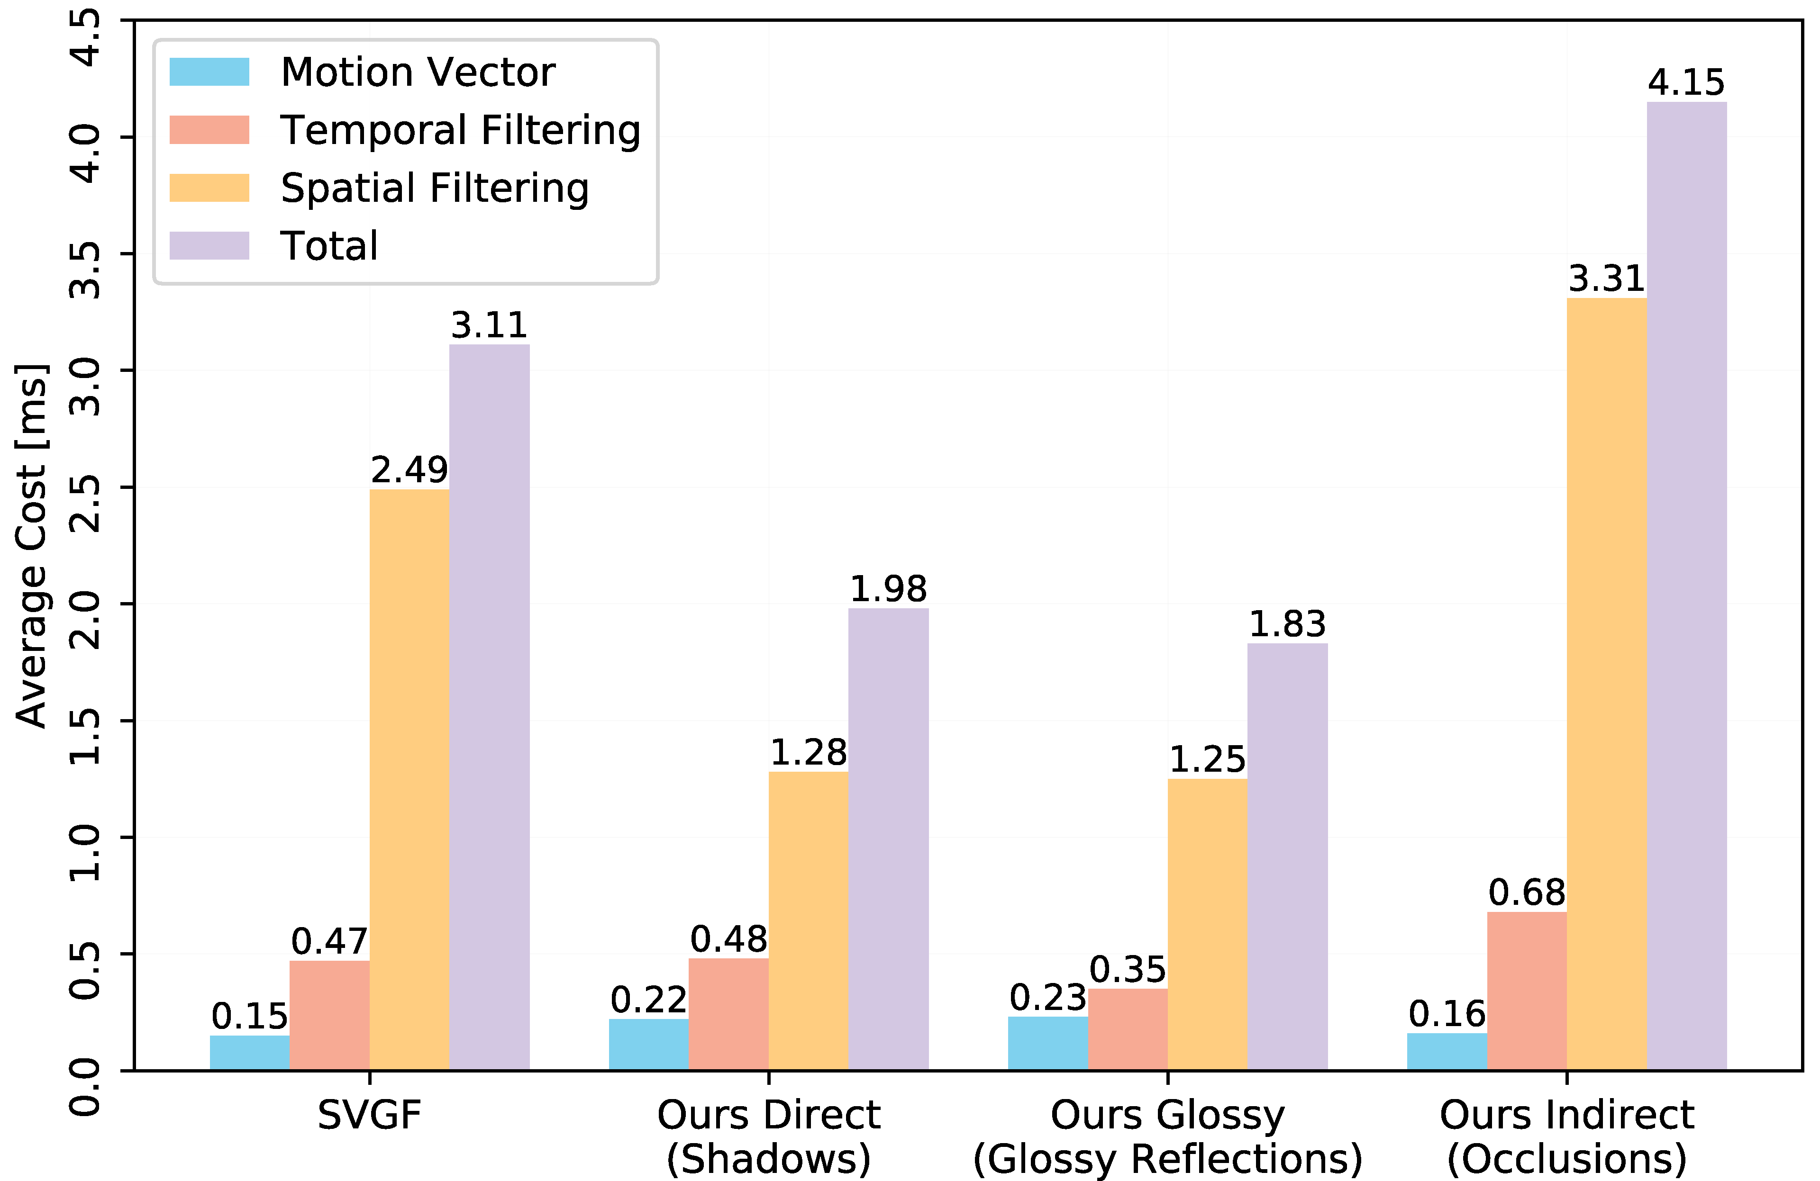
Performance
Notes:
Here we show the performance of our motion vectors.
We compared with SVGF using traditional motion vectors.
Different from previous work, our main contribution is not a spatial filtering approach or system, but the different types of motion vectors.
As one would expect from their simple computation, in practice, we observed only a negligible performance cost by replacing with our motion vectors.

Slide 49
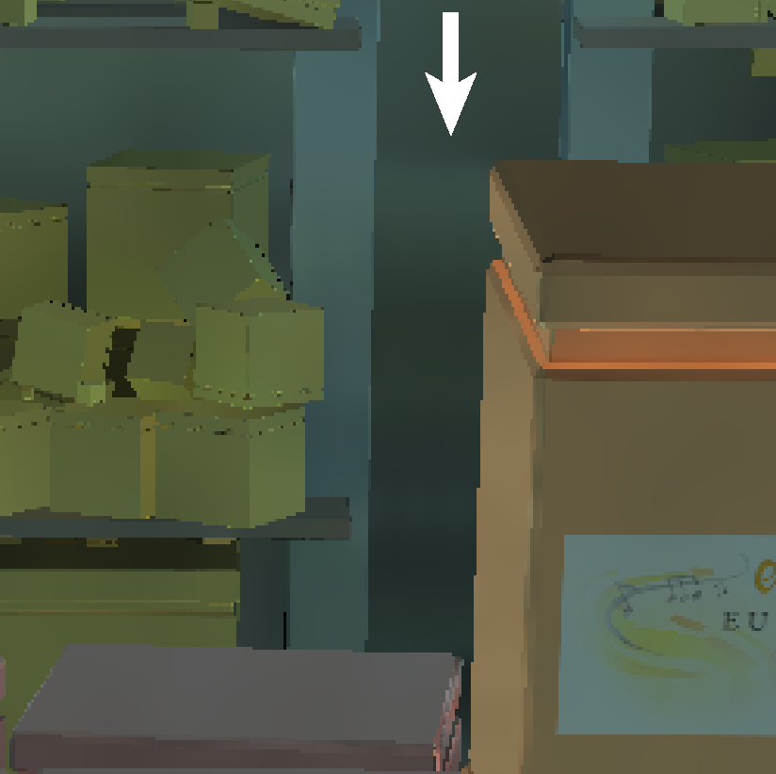
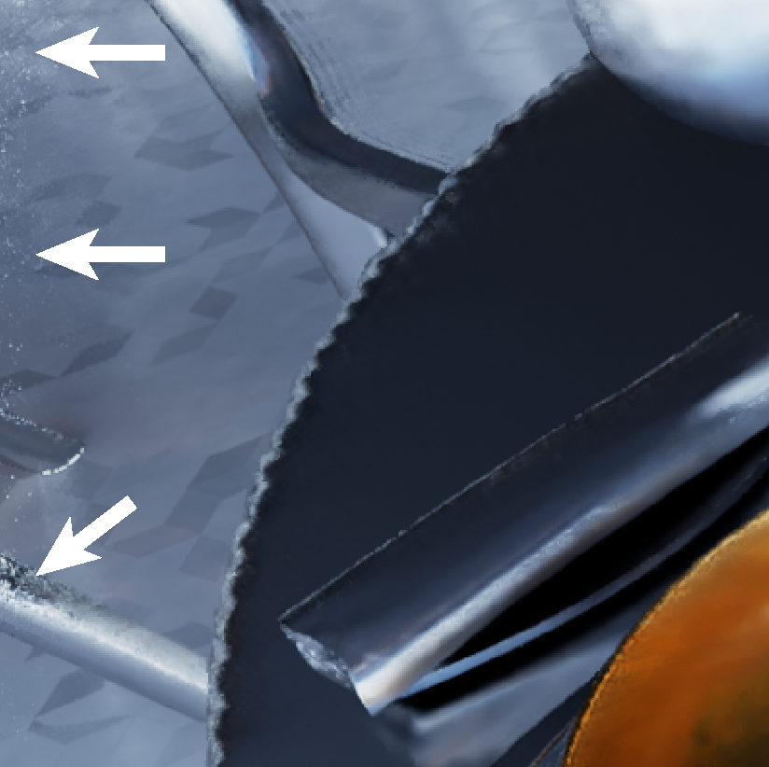
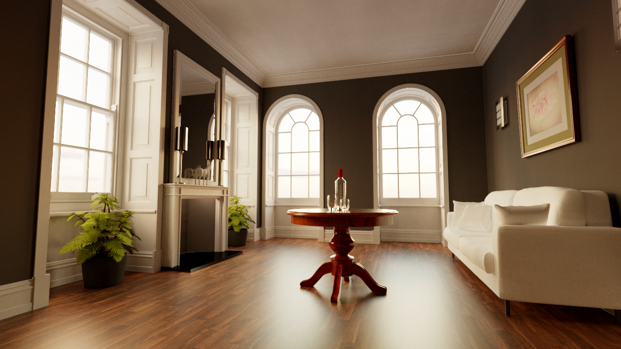
Limitations
Ghosting due to the sudden change of local irradiance
The out of image plane issue
Failure due to drastic temporal change
…
Notes:
There are some limitations of our method.
For example,
(c1) When filtering the occlusions, sometimes our method will still introduce faintly visible ghosting due to the intensely varied irradiance in the local area.
(c2) Also, currently, we do not explicitly handle the cases where the motion vectors point to regions outside the image plane.
(c3) Moreover, When the temporal change is too drastic, there is barely any temporal information that we can use. One typical case is the sudden switch of scenes.

Slide 50
Conclusion
Notes:
Now, let’s wrap up.

Slide 51
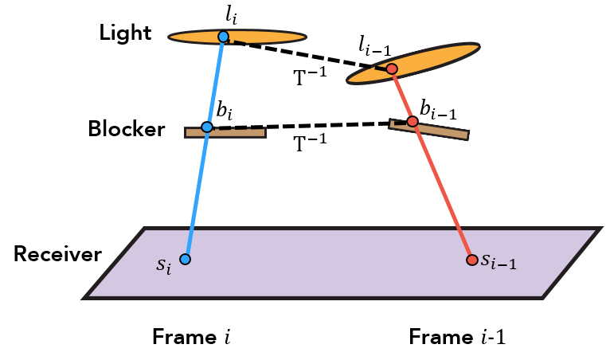
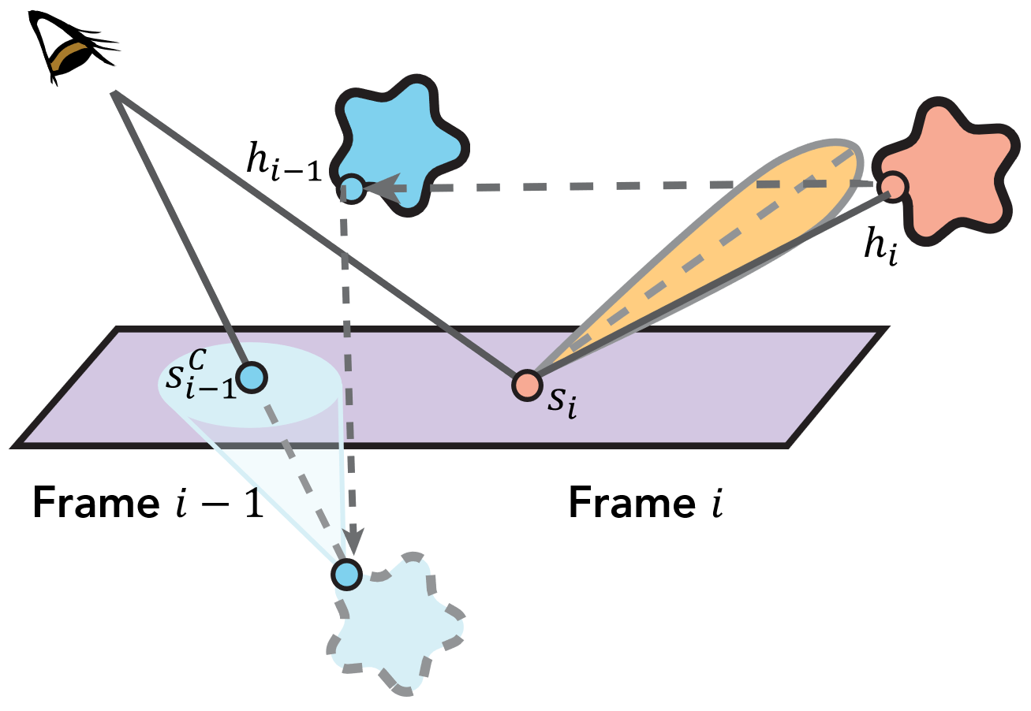
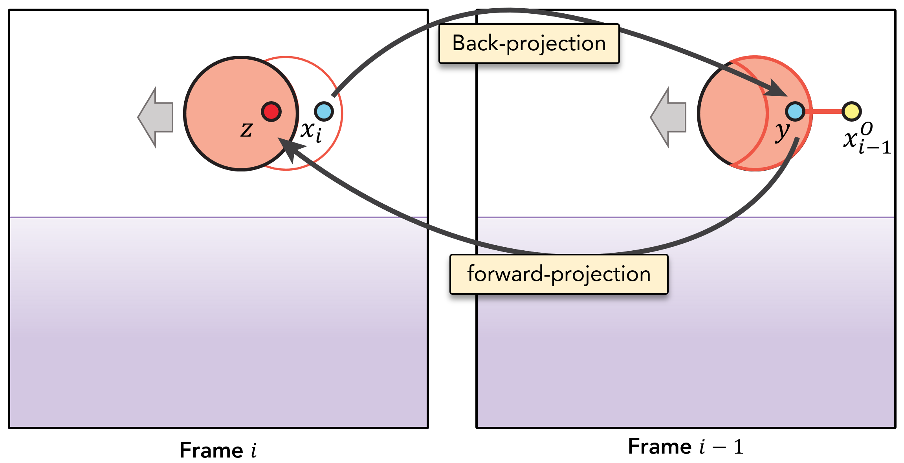
Conclusion
Three types of motion vectors
Shadow motion vector
Stochastic glossy ref. motion vector
Dual motion vector
Temporally reliable
Negligible performance overhead
Production-ready
Notes:
We have proposed multiple types of motion vectors for better utilization of temporal information in real-time ray tracing.
(c1)We show that our motion vectors are temporally more reliable than traditional motion vectors,
(c2)with negligible performance overhead.
(c3)And they are production ready.

Slide 52
Future work
Temporally reliable motion vector for distribution effects
Motion blur, depth of field, etc.
Study non-exponential temporal falloffs
Machine learning
Notes:
In the future, we would like to design temporally reliable motion vector for distribution effects, such as motion blur and depth of field effects.
(c1)It would also be interesting to keep multiple previous frames to study non-exponential temporal falloffs.
(c2)
Exploiting machine learning approaches to better summarize temporal correlations from examples could also be a promising direction.

Slide 53
Temporally Reliable Motion Vectors for Real-time Ray Tracing
Zheng Zeng¹, Shiqiu Liu², Jinglei Yang³, Lu Wang¹ and Ling-Qi Yan³
Notes:
Thanks for your attention, and I’d be happy to take any questions now.

Slide 54
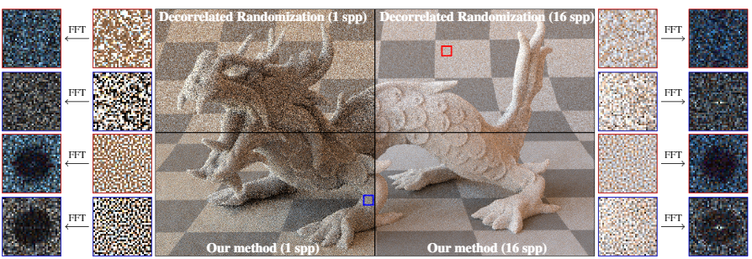
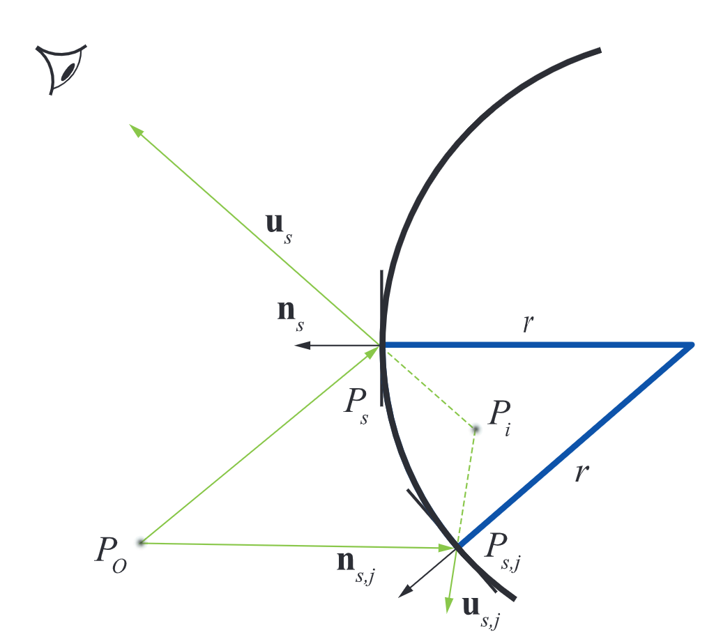
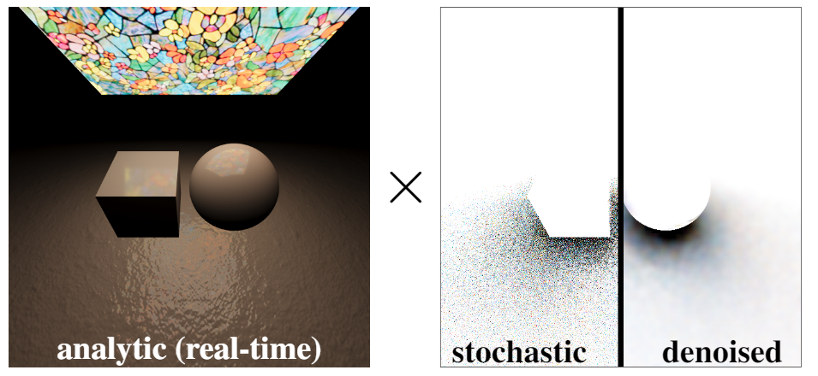
Potential improvements
Gain Potential improvements with orthogonal approaches:
Better spatial filter
Help us to find more accurate motion vectors
Dynamically select blending factor $α$
Blue noise sampling patterns [Heitz et al. 2019]
…
A-SVGF
[Schied et al. 2018]
Finding the mirror-reflected images by curved reflectors [Hirvonen et al. 2019]
Better shadow estimators
[Heitz et al. 2018]
Notes:
Our method could gain potential improvements with orthogonal approaches.
For example,
(c1) any orthogonal method that improves spatial filtering is potentially helpful to our method
(c2) Also, there are better methods that help us to find more accurate motion vectors,
(c3) Moreover, adaptive methods that dynamically select temporal blending weights such as A-SVGF can also be combined with our method immediately for better temporal robustness.

